Slide 1
BIA 3000 Final
John Rees

Slide 2
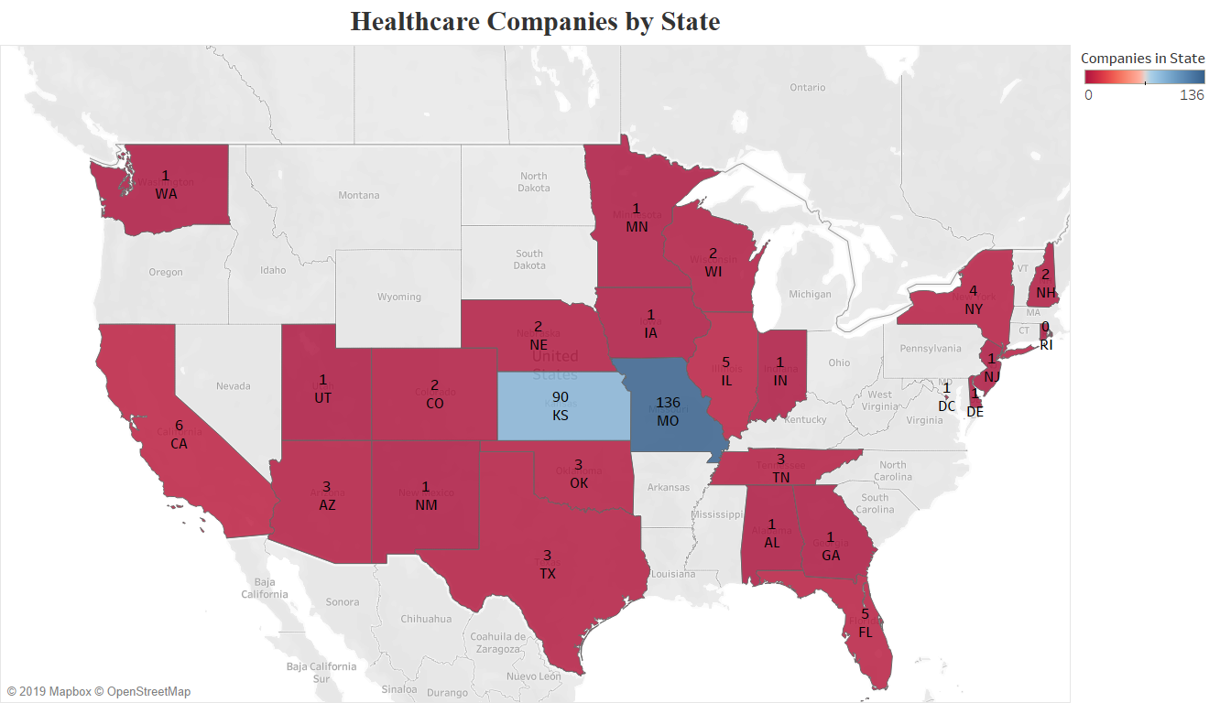
Healthcare Companies in the United States
Notes:
The first slide comprises a map of all the healthcare companies listed in the dataset. Companies in Australia and Canada are left out for a greater focus and emphasis to be put on the United States. As we can see from the map, Missouri and Kansas make up the greatest bulk of company concentrations. Between them, the two states are home to the vast majority of healthcare companies. Not shown in the PowerPoint photo is the inclusion of a dropdown filter that gives the user the ability to hide whatever states they deem fit.

Slide 3
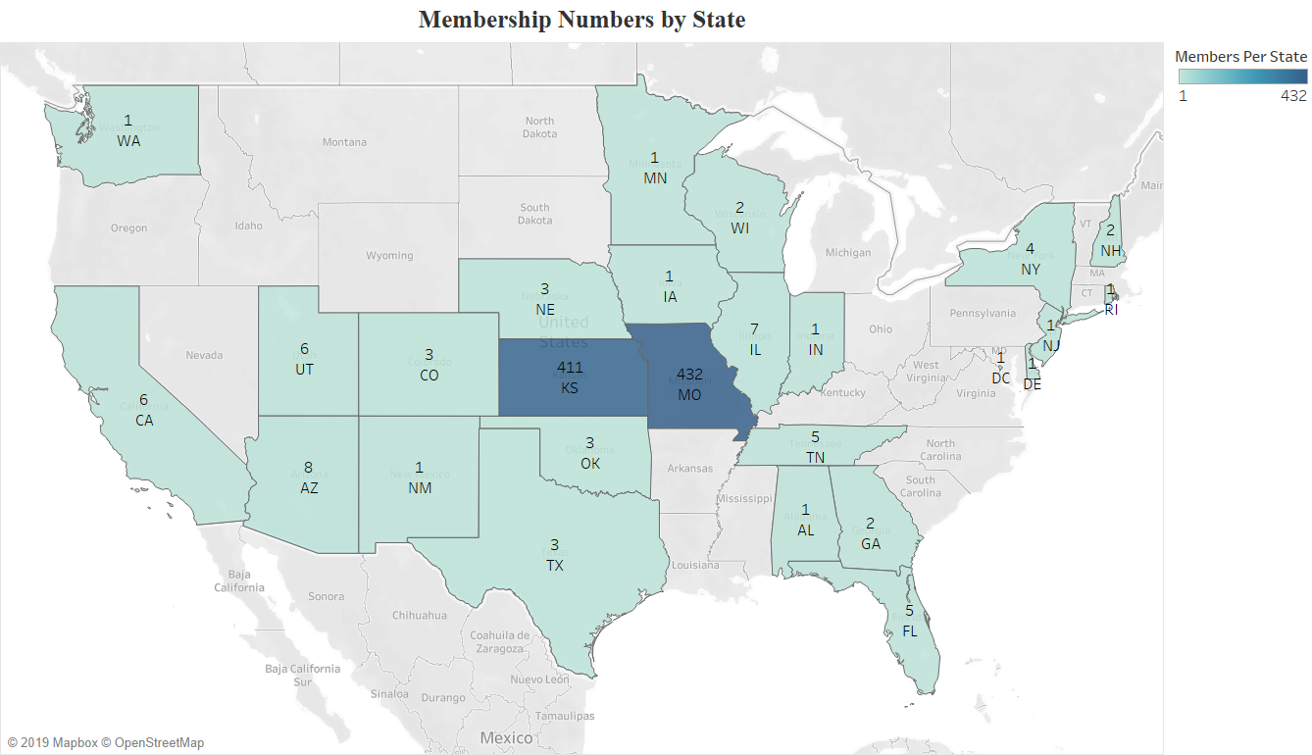
Membership Numbers by State
Notes:
Slide two is very similar to slide one, except now it focuses on the amount of members in each state. As was expected given the power Missouri and Kansas hold, they too make up the majority of memberships. Slides one and two tell us that the lion’s share of our efforts, whether that be advertising, capital spent, recruitment, etc. Should be focused on the Midwest. With that being said, over time we could start an expansion operation to the neighboring states of Arkansas, Mississippi, and Kentucky.

Slide 4
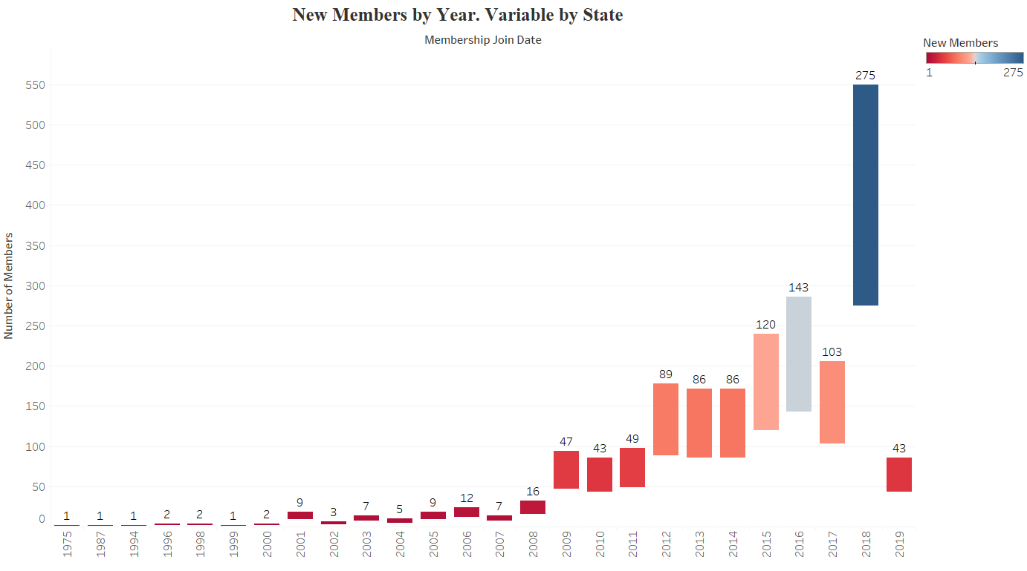
New Members by Year
Notes:
Slide three expands our look on membership data, by showing us our pull of new members by year. As we can see, from 1975-2007 we were not drawing in many new members. What is important though is that from 2008-2019 we have been drawing in hordes of new members. In fact, in two years, 2009-2010, we gained more people than in the previous twenty plus years combined. Our best year to date was 2018. During 2018, we added another 275 members. Also, as it has been in the previous two slides, there is an adjustable filter that is not shown in the photo. This filter allows the user to filter out certain states. When the filter is applied to just show Kansas and Missouri, the results again show that Kansas and Missouri make up for the majority of collected data.
The table is a standard waterfall table utilizing “Aggregate Number of Members”, and “Year of Membership Join”. Also there is an available filter that allows you to filter out certain states. In addition to this, a second filter allows you to remove certain years. The colors chosen are red-blue diverging with no step. Red of course representing years who had a poor number of new members. Blue represents good years. Due to 2018 being an outlier, the colors can be skewed. This is rectified by removing 2018 from the filter.

Slide 5
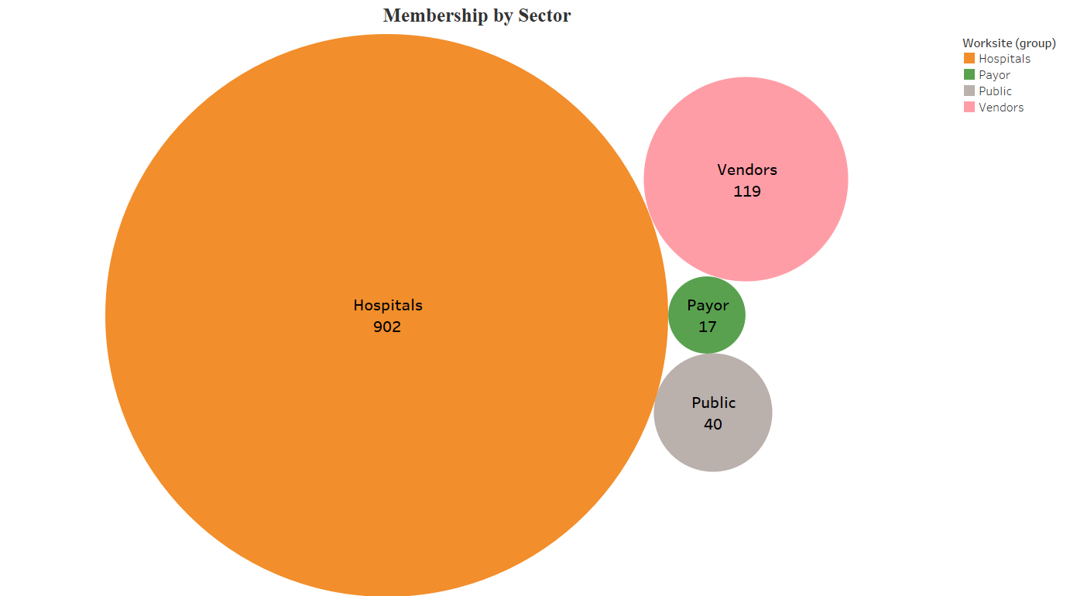
Membership by Sector
Notes:
Membership by sector shows us exactly that. What is of interest here is the heavy focus on the hospital sector. Hospitals on their own account for almost 9/10th’s of total members.
Membership by sector was created by creating 4 separate sets; Hospitals, Vendors, Payor, and Public. Then a calculated field utilizing Worksite (group) and Total Number of Members was created.

Slide 6
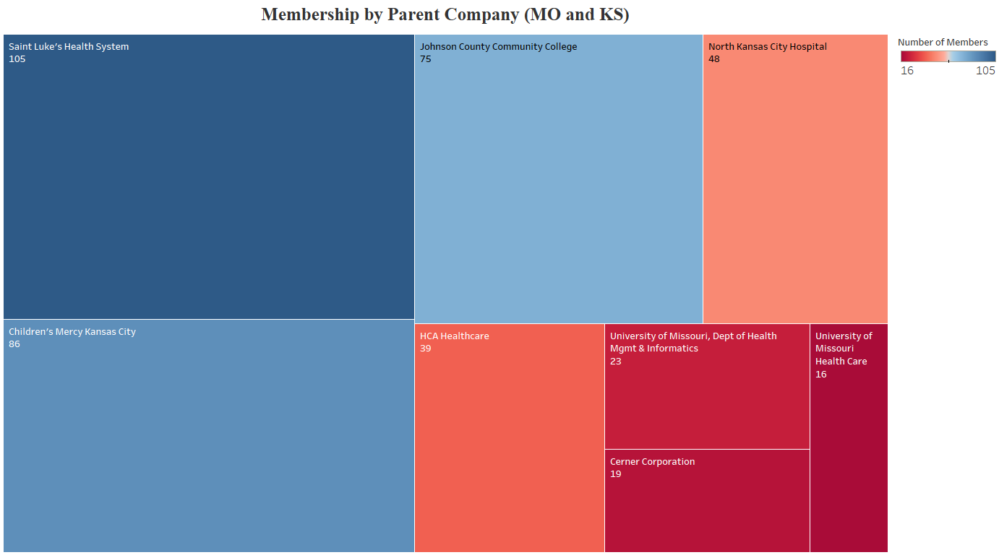
Membership by Parent Company
Notes:
Slide 5 covers how many members we have from which company. The data is limited to data from Missouri and Kansas as those two states provide the majority of information. Also excluded is the University of Kansas Hospital Authority. The reason for this was it accounted for over 200 memberships. This heavily skewed the visual as it took up more than half of the slide. As we can see, Kansas City is home to several companies with large amounts of members. Saint Luke’s, Johnson County Community College, North Kansas City Hospital, Children’s Mercy, and Cerner all account for a large portion of memberships. These companies are mainly in the hospital sector, so it is no surprise that they make up a great deal of total members.
This slide was created using the “Parent Company Name” and “Aggregate Number of Members”. Included with the slide is a filter allowing the user the ability to filter in and out whatever company he wants from the dataset. There is also a second filter that allows for the filtering of States.

Slide 7
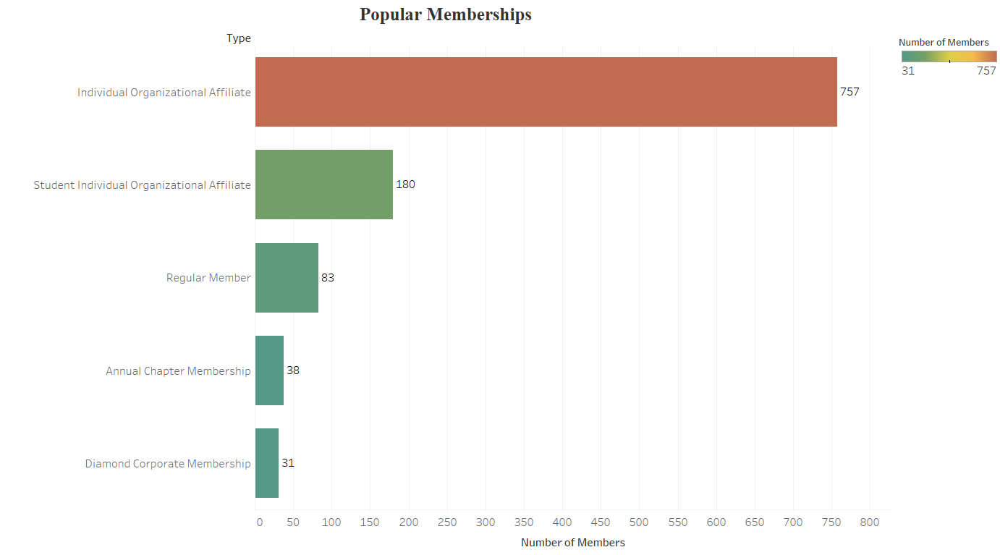
Popular Memberships
Notes:
Slide 6 grants us another insight into the membership data. The six listed types are there as they account for over thirty members. The following slide, “Unpopular Memberships”, includes types who draw less than 29 members. “Individual Organizational Affiliate”, accounts for the greatest number of memberships at 757. Following that is “Student Individual Organizational Affiliate” with 180 members, and “Regular Member”, completing the podium finish with 83 members. Clearly the “Individual Organizational Affiliate” is the most popular membership.
Popular Members was created by utilizing “Total Aggregate Members”, and “Type”. To achieve the desired result, “Type” was put under a conditional filter which removed any types with less than 30 members. Temperature Diverging was chosen for the colors as it allowed for the distinguishing of the most popular result from the rest. It was also chosen because it allows the four other types to remain green. As they are still a popular membership choice I thought it would be counterintuitive to go with a green-red spread as it would look as it they are unpopular.

Slide 8
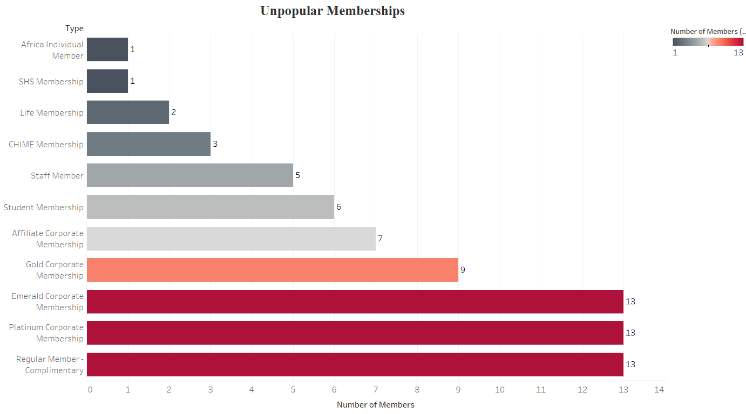
Unpopular Memberships
Notes:
Slide 7 continues from slide 6. Here we get a good look at what the most unpopular membership types are. We can clearly see that the “African Individual Membership”, in conjunction with the “SHS Membership” are the least popular. Also amongst the least popular is the “Student Membership”, this could be an error as the previous slide has a student membership as one of the most popular. If this is an error, it can be put down to a difference in record keeping between different companies. For all we know both memberships could be the same, but, one company just records it as a plain, “Student Membership.”
Unpopular Memberships was created the same was as Popular Memberships. The only difference being the conditional filter removed any types that had more than 29 people.

Slide 9
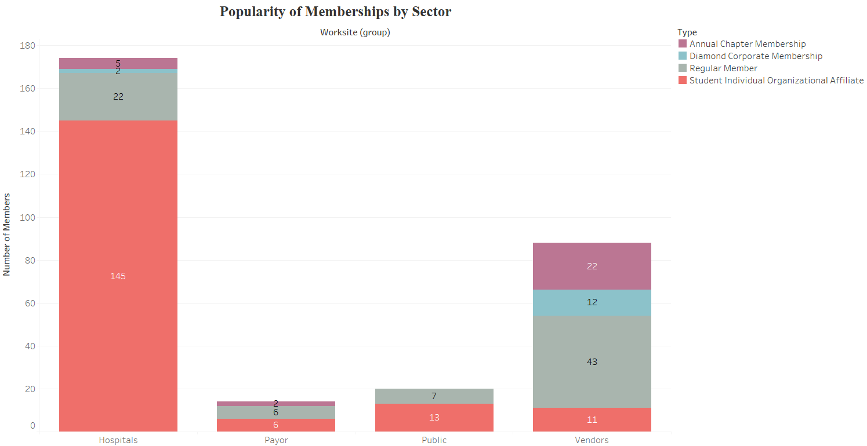
Popularity of Memberships by Sector
Notes:
Slide 8 seeks to clarify some questions from the previous two slides. The main question being, “Why is the Individual Organizational Affiliate” so popular. While we cannot get a definite answer from the available data, we can see that when the filter allows for “Individual Organizational Affiliate”, it is the preferred membership of the hospital sector. As the hospital sector comprises the bulk of overall members, it follows that their preferred membership type would be the most popular.
Slide 8 was composed by utilizing Worksite (group), Aggregate of Total Members, and Type. As mentioned above, there is indeed a filter. The filter allows for the removal of the unpopular membership types. It was also used to remove “Individual Organizational Affiliate”, as it squeezed out most of the room for the bars.

Slide 10
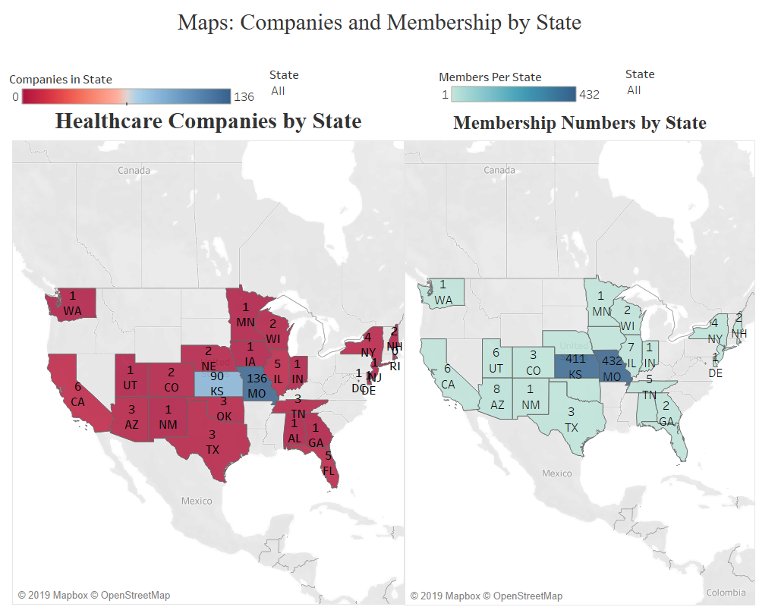
Dashboard 1

Slide 11
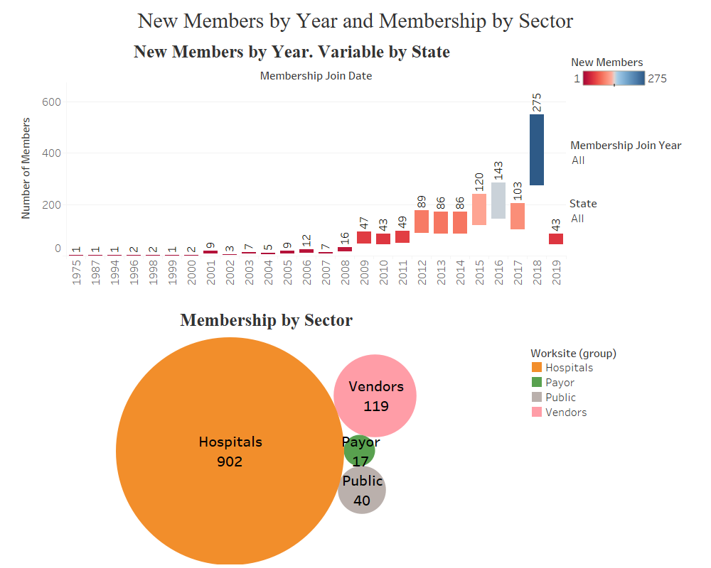
Dashboard 2

Slide 12
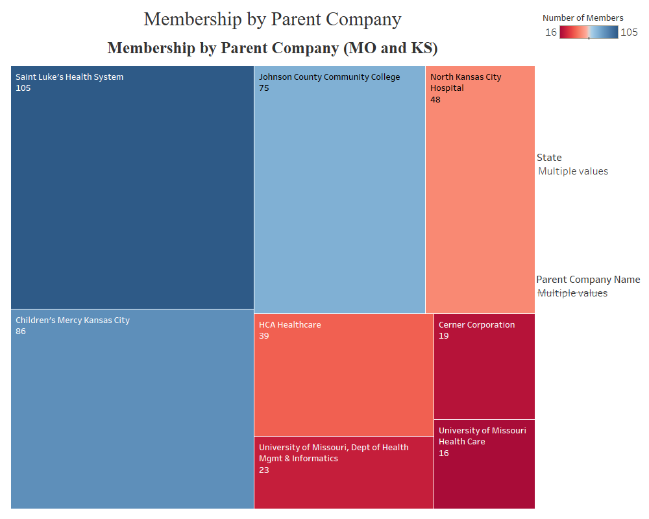
Dashboard 3

Slide 13
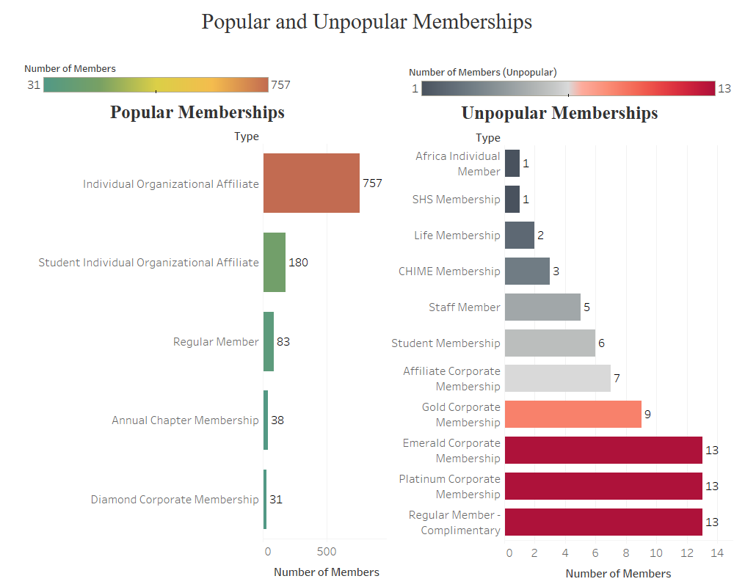
Dashboard 4

Slide 14
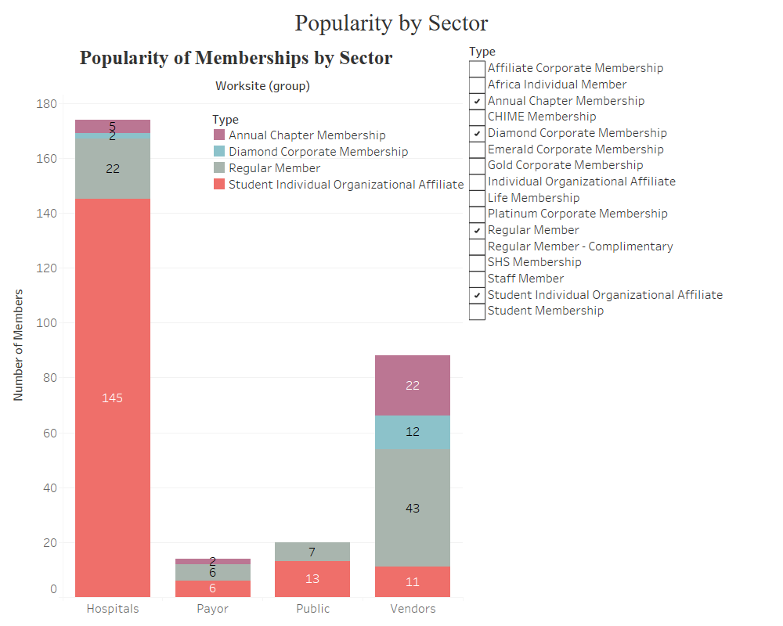
Dashboard 5

Slide 15
Suggestions
Drop the unpopular membership types.
Since there are so few people who utilize these types, there is no use in offering them. Start by seeing if any of the types offer something that is unique. If so, cannibalize the type and add the unique aspect into one of the more popular types.
Shift marketing focus to hospital workers.
If this is not already the case, a great deal of attention should be kept on hospital workers. They make up the bulk of any industry and it would be foolish not to try to make membership types that benefit them. Also since they are such a large group, more marketing emphasis should be put on them.
Expand
Clearly the bulk of operations is centered in Kansas and Missouri. While this is not a major problem, there are several states with absolutely no members or companies. Conduct research into whether an expansion into the untouched states would be viable or worth while.

Slide 16
Questions and Concerns
Possibility of skewed data
The dataset contained information on companies across the United States. However, due to the majority of those companies being located in Kansas and Missouri, conclusions that we draw might be focused more in the micro than the macro. While Missouri and Kansas are large States, they do not provide a full picture of the situation. Also, most of the data came from the hospital sector. I would not feel comfortable making any assumptions covering the different sectors as there is a definite skew towards the hospitals.
Limited data
Although there was quite a lot of data in the dataset, it was quite limited in what it was covering. While I am sure there is a lot of information to be gathered from membership data, I could not help but feel as if it is quite limiting.

